Slide 1
Jane’s View

Slide 2

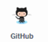
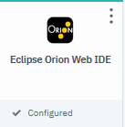
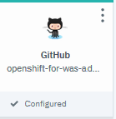
Brokers:
app1

Slide 3
Champ’s View (Kabanero Managed Pipelines and Event Triggers)

Slide 4




Container
Registry
Brokers:
events
Tekton
webhook
Start with blank slate, and additional brokers

Slide 5
Openshift
Container
Registry
Brokers:
events
Tekton
webhook
kabanero
Install Kabanero

Slide 6
Openshift
Container
Registry
Brokers:
events
Tekton
webhook
kabanero
Tekton
Kab1
event
Event- Trigger
pipeline
Create Kabanero Instance

Slide 7
Openshift
Container
Registry
Brokers:
events
webhook
Tekton
kabanero
Tekton
Kab1
event
Container
Registry
events
webhook
Tekton
Event- Trigger
pipeline
Create Tool Instances

Slide 8

Openshift
Container
Registry
Brokers:
events
Tekton
webhook
kabanero
Tekton
Kab1
event
Listener 1
Listener 2
Tekton Tool View: Listeners, Pipelines, and Pipeline Runs, etc

Slide 9
Openshift
Container
Registry
Brokers:
events
webhook
Tekton
kabanero
Tekton
Kab1
event
NATS View: topics

Slide 10
Openshift
Container
Registry
Brokers:
events
webhook
Tekton
kabanero
Tekton
Kab1
event
org1
Repo1
Repo2
Github View: Organizations and Repositories

Slide 11
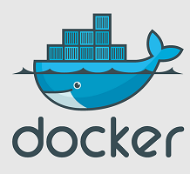
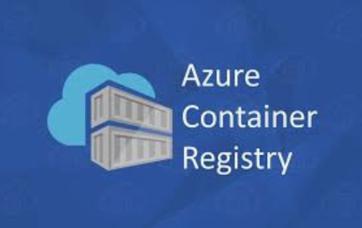

Openshift
Container
Registry
Brokers:
events
webhook
Tekton
kabanero
Tekton
Kab1
event
Google
Container Registry View

Slide 12
Openshift
Container
Registry
Brokers:
events
webhook
Tekton
kabanero
Tekton
Kab1
event
org1
webhook
Repo1
webhook
Repo2
webhook
Webhook View: Repos and Webhooks

Slide 13

Openshift
Container
Registry
Brokers:
Tekton
events
webhook
kabanero
Tekton
Kab1
event
tri
Listener 1
Mediation 1
tri
Listener 2
webhook
Other listener
webhook
tri
tri
Mediation 2
Other listener
webhook
Events View: mediations, connections

Slide 14
Backup

Slide 15
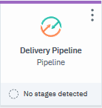
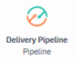
events
events
webhook
Google
publisher
subscriber
sender
listener
event
event
webhook
Container
Registry
Tekton
Tekton

